Slide 1
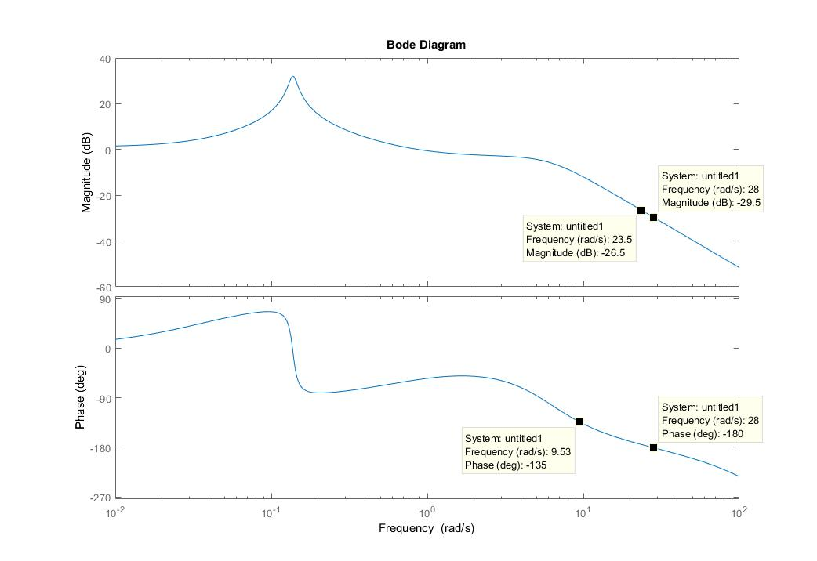
Gain margin
Gain Bandwidth
+6dB
$$ω_{180}$$
Phase Bandwidth
+45deg

